Slide 1
Genetic Disorder
LS1201

Slide 2
A genetic disorder is a disease caused by a change in the DNA sequence which causes a deviation from the normal sequence
Genetic disorders can be caused by:
A mutation in a single gene (monogenic disorder)
Mutations in many genes (multifactorial inheritance disorder)
A combination of gene mutations and environmental factors
Chromosomal damage (alteration in the number or structure of chromosomes).

Slide 3
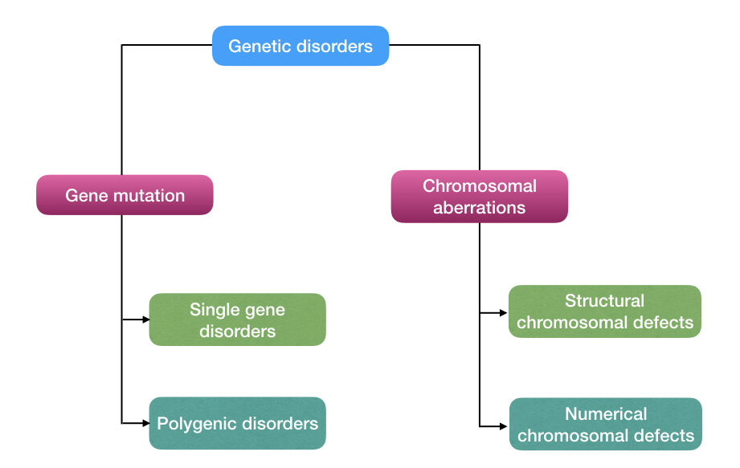
Types of genetic disorders

Slide 4
Single gene disorders
Single gene disorders are caused by changes in DNA sequence in one particular gene.
These diseases are most commonly inheritable.
The mutated version of the gene responsible for the disorder is the mutated allele.
Single gene disorders may be dominant-
when one mutant copy of the gene is sufficient to cause the disease.
Single gene disorders can be recessive-
when both the copies of the gene should be mutated to cause the disease.

Slide 5
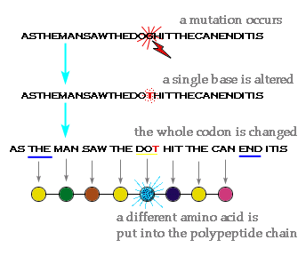
Single gene disorders

Slide 6
Polygenic Disorder
A genetic disorder that is caused by the combined action of multiple genes.
These genes can either act independently or can interact with each other.
Diabetes
Cancer
Polygenic Disorder
Hypertension
Heart disease

Slide 7
Chromosomal abnormalities
Can be due to numerical abnormalities or structural abnormalities
Numerical Abnormalities:
A normal diploid human cell consists of 46 chromosomes.
Aneuploidy is the most common form of chromosomal abnormality.
It refers to the presence of an extra chromosome or a missing chromosome.
In the case of Down's syndrome or Trisomy 21, there is an additional copy of chromosome 21 so there are 47 chromosomes.
Turner's syndrome on the other hand arises from the absence of an X chromosome, meaning only 45 chromosomes are present.

Slide 8
Chromosomal abnormalities
Can be due to numerical abnormalities or structural abnormalities
Structural Chromosomal Abnormalities:
Structural chromosome abnormalities occur in the following conditions:
When part of a chromosome is missing.
A part of a chromosome is extra .
A part has switched places with another part.
Ultimately, this leads to having too much or too little genetic material.

Slide 9
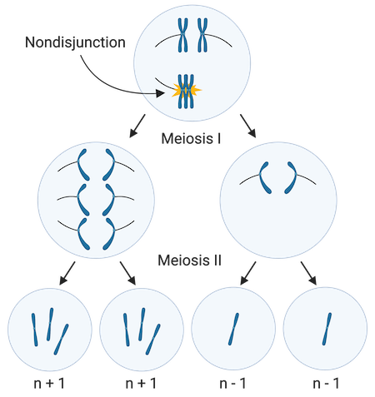
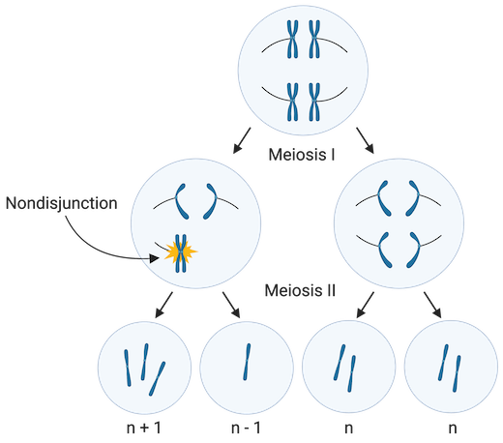
Chromosomal abnormalities
Numerical chromosomal abnormalities are caused by nondisjunction:
It occurs during two circumstances:
When pairs of homologous chromosomes fail to separate during meiosis I.
When sister chromatids fail to separate during meiosis II.

Slide 10
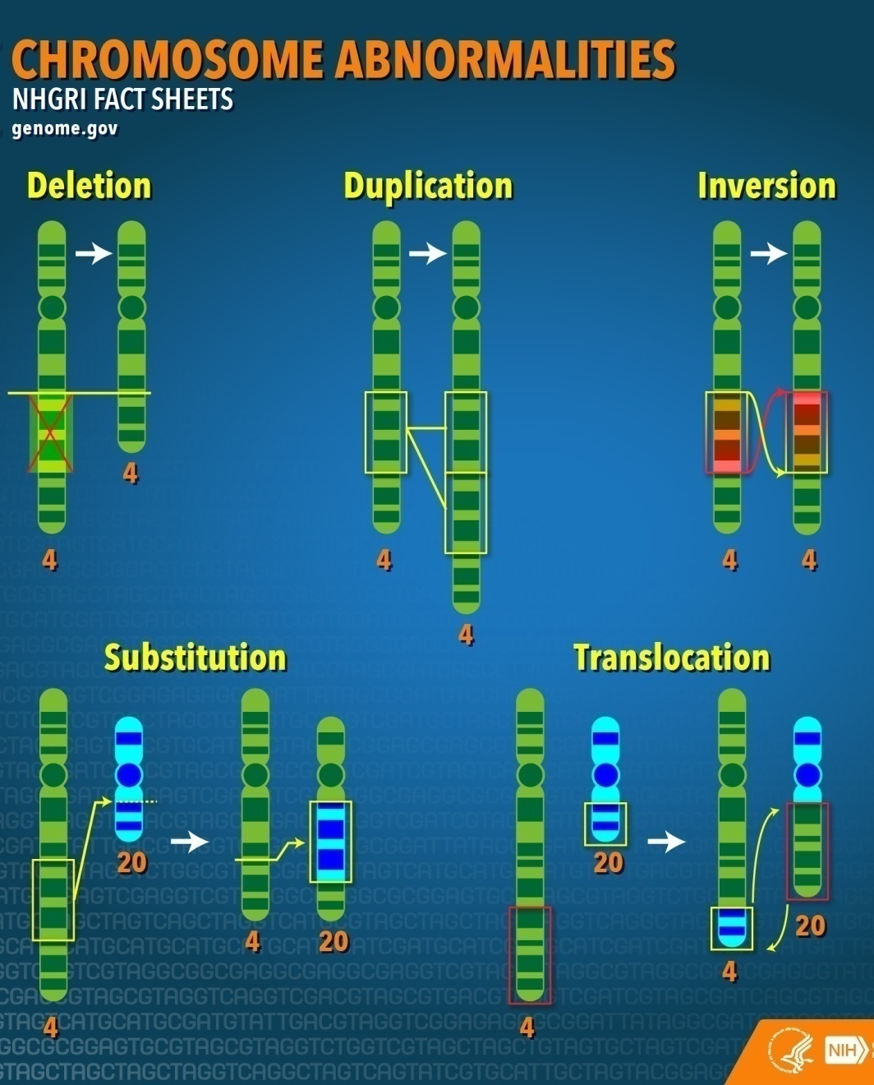
Chromosomal abnormalities
Deletion- A part of the chromosome is deleted.
Duplication- A part of the chromosome is duplicated.
Inversion- two breaks occur in one chromosome but when they rejoin the sequence orientation in that portion of the chromosome get inverted. This may involve whole genes or a portion of genes.
Substitution- A portion of the chromosome breaks and reattaches to another chromosome.
Translocation- when there are breaks in two separate chromosomes and the parts are interchanged,

Slide 11
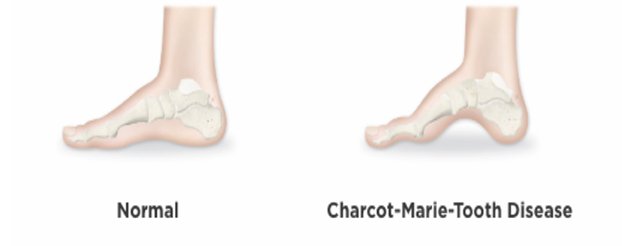
Charcot Marie tooth disease
Charcot Marie Tooth disease is an inherited neurological disease.
There is a slow progressive degeneration of the muscles in the foot, lower leg, hand, and forearm
There is also a mild loss of sensation in the limbs, fingers, and toes.

Slide 12
Charcot Marie tooth disease
CMT is caused by mutations in genes that are involved in the structure and function of either the peripheral nerve axon or the myelin sheath.
Although different proteins are abnormal in different types of CMT, one common factor is that all of the mutations mainly affect the normal function of the peripheral nerves
So either there are abnormalities in the myelin sheath or in the peripheral nerve axon

Slide 13
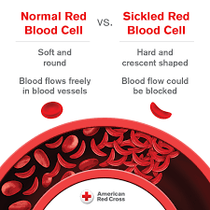
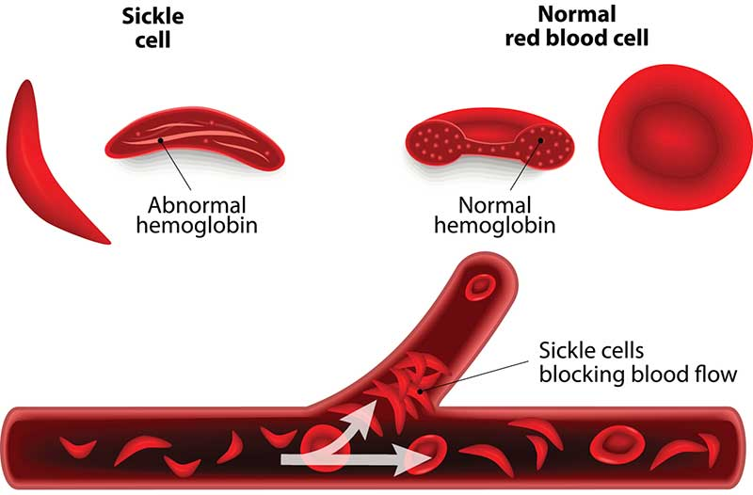
Sickle Cell Anemia
Sickle cell disease is an inherited red blood cell disorder.
Hemoglobin is a protein in red blood cells that carries oxygen. In SCD, the hemoglobin forms stiff rods within the red blood cells. This changes the shape of the red blood cells from the normal disk shape to abnormal sickle shape.
The sickle-shaped cells are not flexible. Many of them burst apart as they move through blood vessels. The sickle cells usually only last 10 to 20 days, instead of 90 to 120 days.
So the body may face trouble making new cells to replace the ones that is lost. This results in anemia.

Slide 14
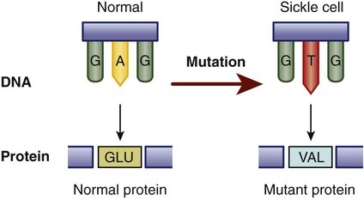
Sickle Cell Anemia
Sickle Cell Anemia is caused by a mutation in the hemoglobin beta gene.
The gene defect is a single nucleotide mutation which results in glutamate being substituted by valine .
It is an autosomal recessive disorder.

Slide 15
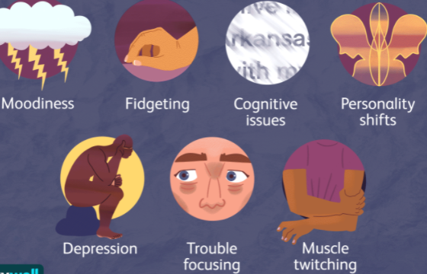
Huntington Disease
Huntington's disease is caused by a mutation in a single gene (HTT).
It is an autosomal dominant disorder.
It is a progressive brain disorder that causes emotional problems, depression, loss of cognition, thinking ability, uncontrolled movements, small involuntary movements.

Slide 16
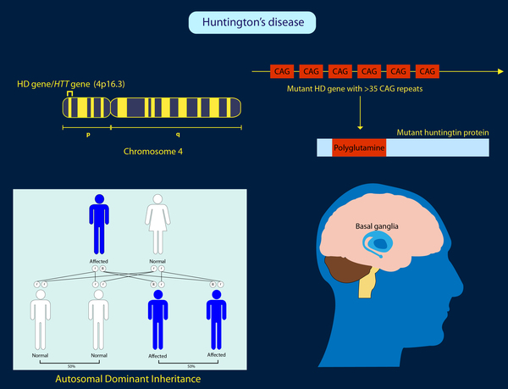
Huntington Disease
The HTT mutation that causes Huntington disease involves a DNA segment known as a CAG trinucleotide repeat.
This segment is made up of a series of three DNA nucleotides (cytosine, adenine, and guanine) that appear multiple times in a row.
Usually the CAG segment is repeated 10 to 35 times within the gene.
People with Huntington disease have the CAG segment repeated 36 to more than 120 times.

Slide 17
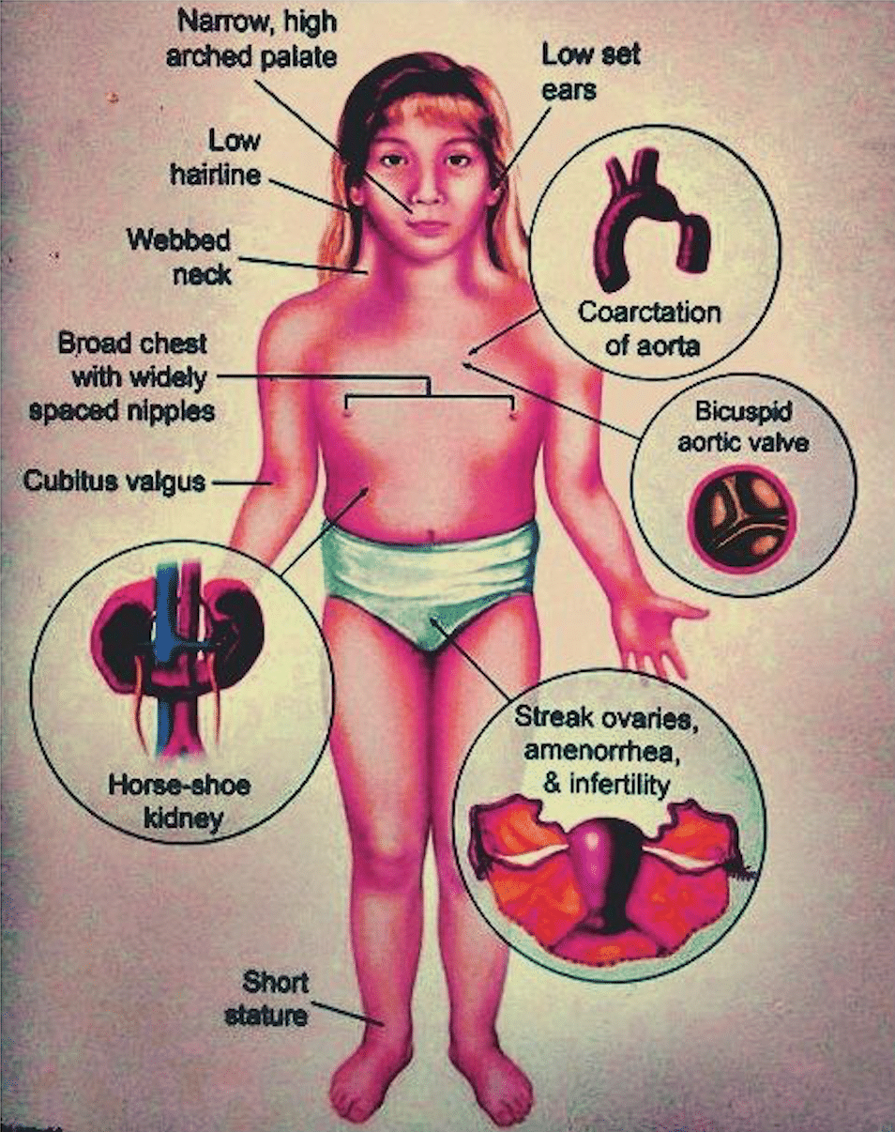
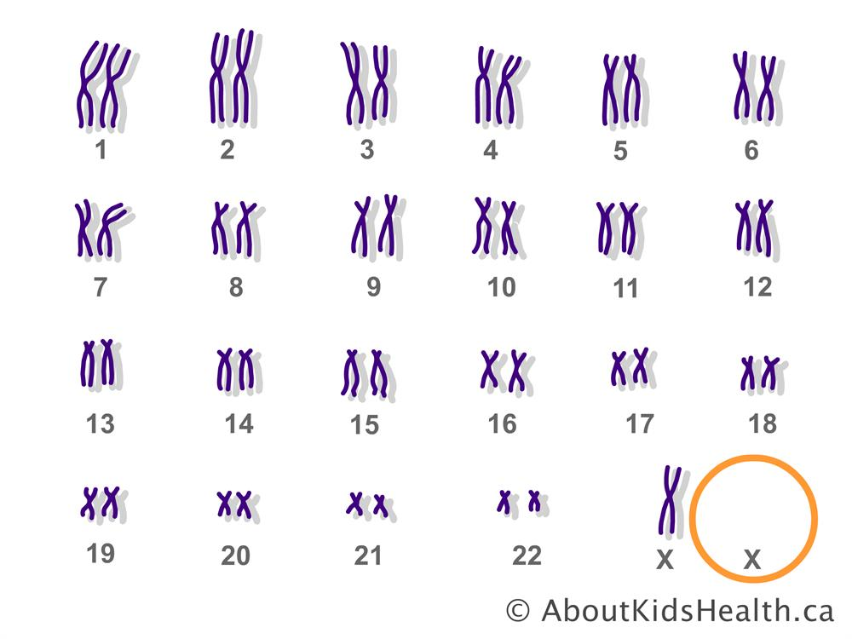
Turner Syndrome
Turner syndrome affects only females. It results when one of the X chromosomes is missing or partially missing.
The most common feature of Turner syndrome is that females have a short stature There is also an early loss of ovarian function.
Many affected girls do not undergo puberty unless they receive hormone therapy, and most are infertile.

Slide 18
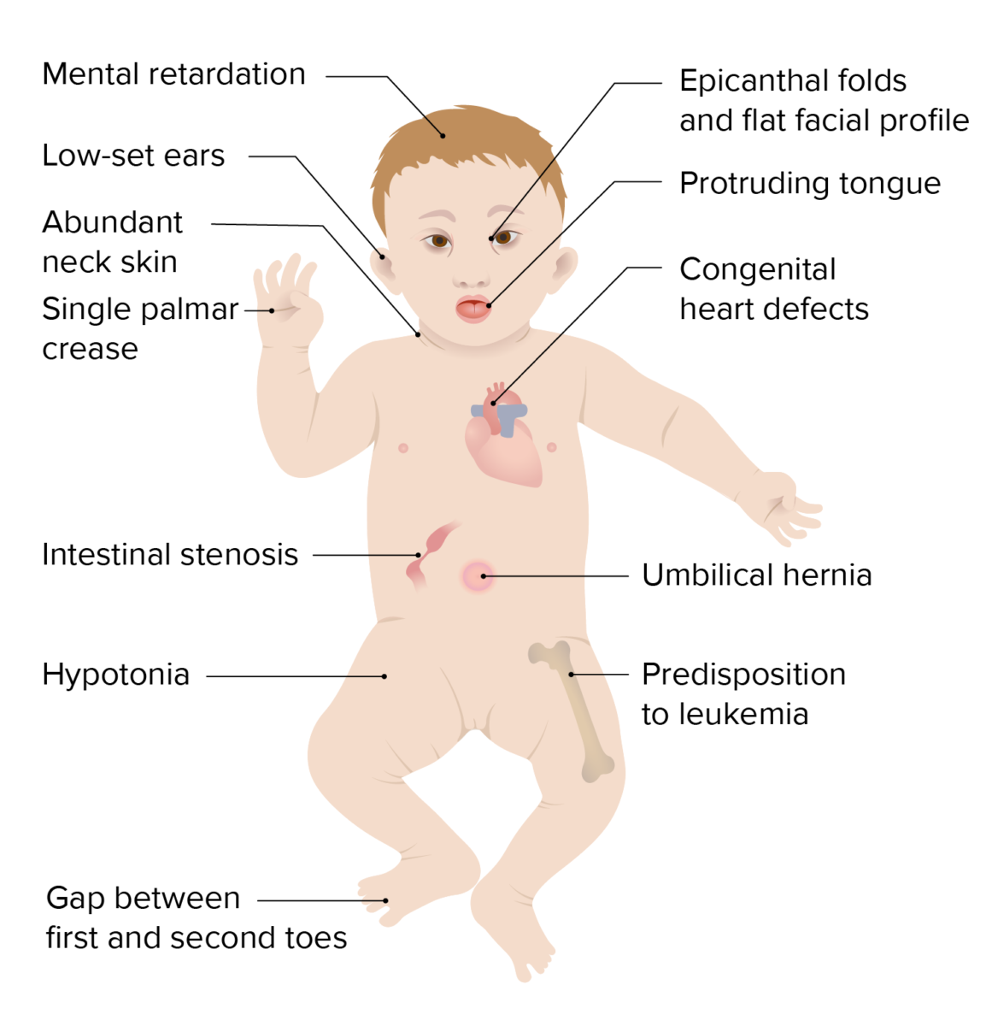
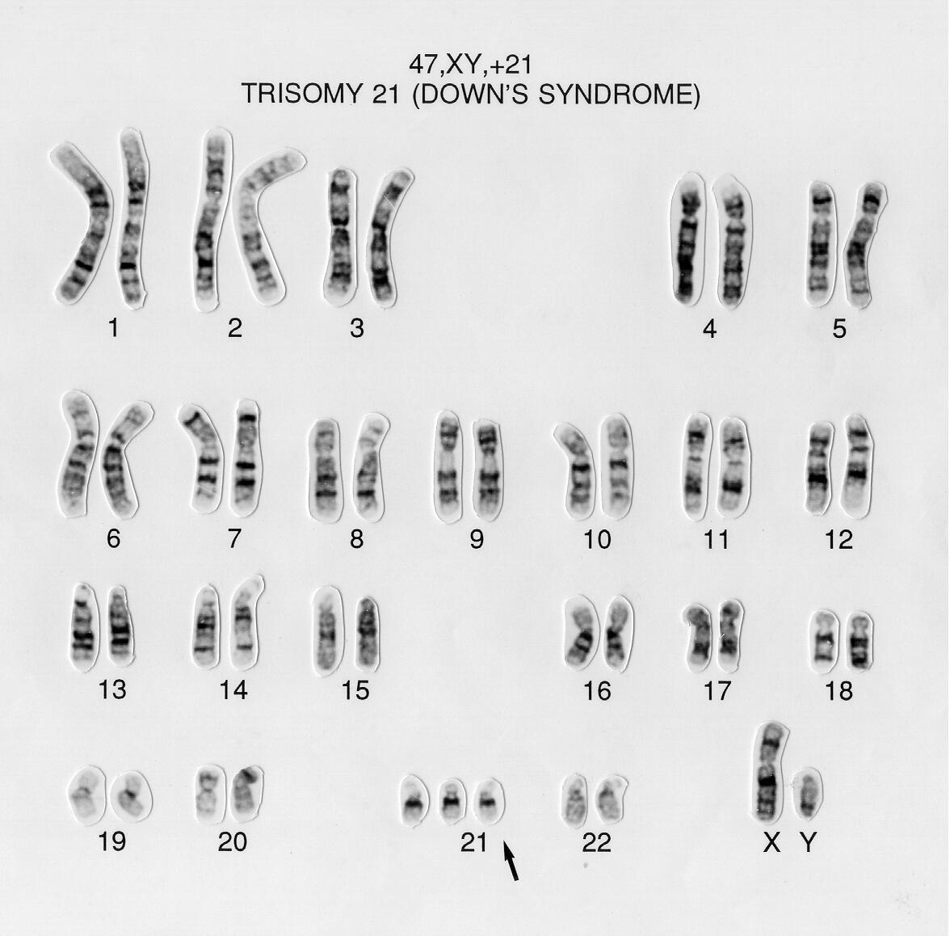
Down Syndrome
Down syndrome is caused when abnormal cell division results in an extra copy of chromosome 21 (full copy or partial copy).
This extra genetic material causes developmental changes in Down syndrome.
It causes lifelong intellectual disability, learning disabilities and developmental delays.
It also causes other abnormalities, including heart and gastrointestinal disorders.

Slide 19
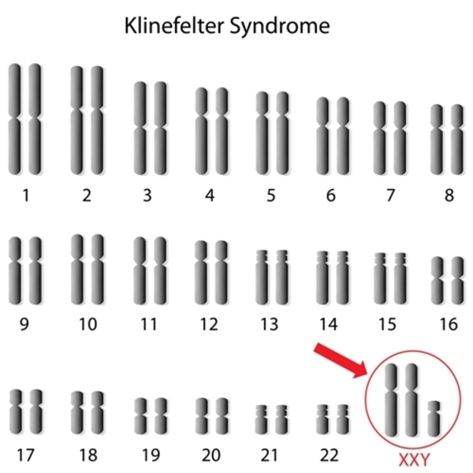
Klinefelter Syndrome
Klinefelter syndrome is a genetic condition where a boy is born with an extra copy of the X chromosome. It affects males, and often isn't diagnosed until adulthood.
Klinefelter syndrome may affect testis growth, resulting in smaller than normal testicles. This can lead to lower production of testosterone.
The syndrome may also cause reduced muscle mass, reduced body and facial hair, and enlarged breast tissue.

Slide 20
How can Genetic Diseases be treated or managed?
Many genetic disorders result from gene mutation present in every cell of the body. As a result these disorders cannot be cured. However some approaches may be able to treat or manage some of the symptoms.
For example Metabolic genetic disease where a specific enzyme of metabolism is mutated, treatments like a change of diet can be useful.
Genetic disorder causing a heart defect might be treated with surgery to repair the defect or a heart transplant can be done.
Sickle cell anemia and other blood related disorders can sometimes be treated with a bone marrow transplant.
Bone marrow transplantation can allow the formation of normal blood cells.
Gene Therapy!!

Slide 21
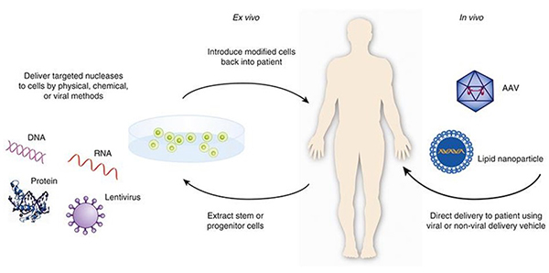
Gene Therapy
Gene therapy holds promise for the futrure for treating a wide range of disases.
It is a technique that replaces a faulty mutated gene or adds a new gene in an attempt to cure a disease or improve the body's ability to fight disease.
Gene therapy is currently under clinical trials.

Slide 22


